Slide 1


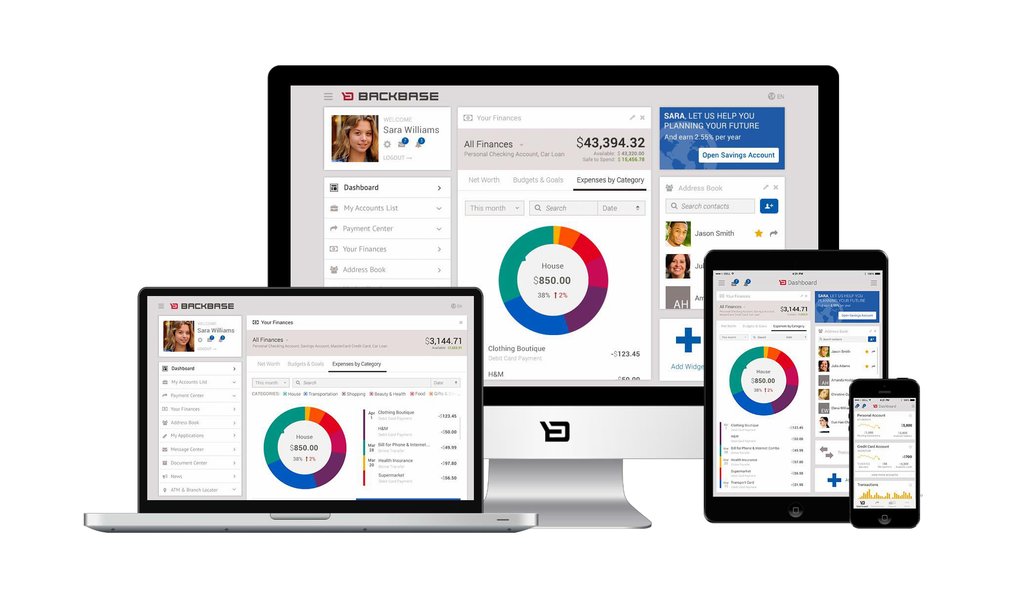
Portal Tools
Focus Area: Foundation

Slide 2
Training Overview
Group Workshop
Back-end
Front-end
Services Integration
Content Services
Advanced Security
Overview
Widget Development
Template Development
Targeting
Publishing
Portal Client
ICE
Foundation
Portal Essentials
Portal Technologies
Portal Tools
Portal APIs
2

Slide 3
Objectives
1. Become familiar with the CXP
Manager
Managing catalogs,
Managing pages, layouts, and widgets
Managing portal rights
Become familiar with the CXP
Explorer
Import XML model configuration

Slide 4


CXP Manager
Portal Tools

Slide 5

CXP Manager Demo
Create a portal, edit it’s settings, permissions and
special pages
Go to Pages, add a new page and base it on a
master page. Edit it’s permissions.
Add a container and some widgets to your page. Show the widget chrome and edit widget settings and permissions.
Preview the Page
Show the Portal Catalog

Slide 6

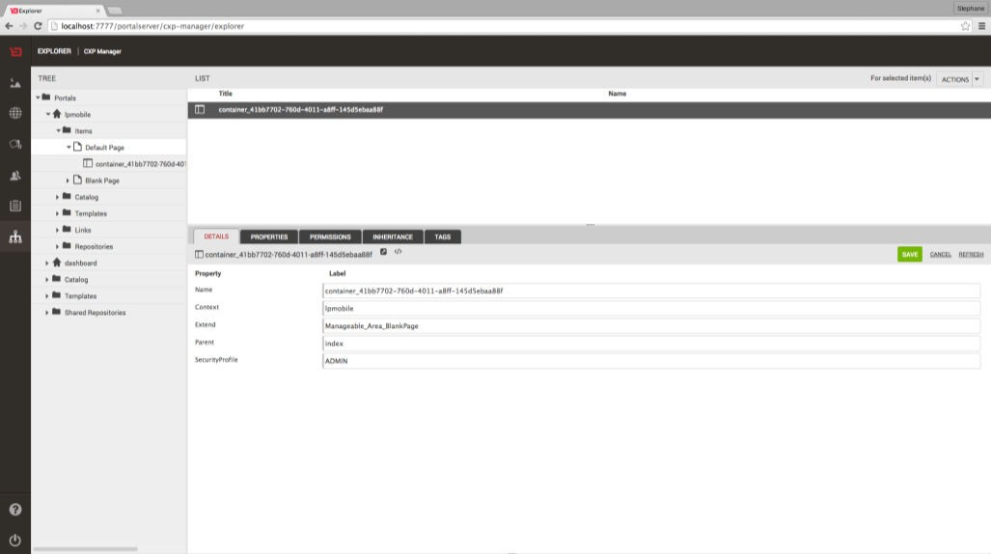
CXP Explorer Demo

Slide 7

The Import Tool
Portal Tools
7

Slide 8
The Import Tool
Auxilary tool
Import objects to the CXP database
Populate the database with the portal structure specified in XML import files.
Useful for starting a project or migrating to a new server.

Slide 9
Importable Objects
Server Scope
Portal Scope
Portal catalog
Pages
Containers
Widgets
Links
Users
Groups
Templates
Masterpages (to enterprise catalog)
Containers (to
enterprise catalog)
Widgets (to enterprise catalog)
Portals

Slide 10














Import Scripts and Files
MODEL
Pages
Templates
TemplateFile (JSP or SOY)
Page
Parent TemplateName
Template
Name
DefaultDevice
TemplateFile
(JSP or SOY)
Web
Smartphone
TemplateFile (JSP or SOY)
Tablet
Containers
Template
Name DefaultDevice
TemplateFile (JSP or SOY)
Container
Parent
Web
TemplateName
Smartphone Tablet
TemplateFile (JSP or SOY)
Widgets
Widget
Template
Name DefaultDevice Web
TemplateFile
(JSP)
Parent
TemplateName
Smartphone
Tablet
TemplateFile (JSP)
11

Slide 11
metadata.xml
<backbaseArchiveDescriptor>
<description>Backbase Archive</description>
<includesContent>false</includesContent>
<packageId>Portal-hello-portal-3b9d6d3a-8d67-4f46-8a8d-
82cdcce64213</packageId>
<versionId>5.6.0</versionId>
<bbexport>
<order>bundleId,bundleName,portals,masterPages,portalContainers,portalWidgets,pa ges,containers,widgets,portalRights,links</order>
</bbexport>
</backbaseArchiveDescriptor>

Slide 12
myportal.xml
<portals>
<portal>
<contextItemName>[BBHOST]</contextItemName>
<name>hello-portal</name>
<properties>
<property name="DefaultDevice">
<value type="string">mixed</value>
</property>
<property name="DefaultLandingPage">
<value type="string">hello-portal/index</value>
</property>
<property name="TargetedDevice">
<value type="string">mixed</value>
</property>
<property name="publishChains">
<value type="string">Self - Direct</value>
</property>
<property name="title">
<value type="string">Hello Portal</value>
</property>
</properties>
</portal>
</portals>
15

Slide 13
mypages.xml
<pages>
<page>
<contextItemName>hello-portal</contextItemName>
<extendedItemName>BlankPage</extendedItemName>
<name>index</name>
<parentItemName>hello-portal</parentItemName>
<properties>
<property name="behaviors">
<value type="string">be.perspective.Manager be.portalClientExt.PortalManagerPreferencesForm</value>
</property>
<property name="bundleName">
<value type="string">dashboard</value>
</property>
<property name="client-template">
<value type="string">page</value>
</property>
<property name="title">
<value type="string">Default Page</value>
</property>
</properties>
<uuid>586a0418-b4b7-41e6-af22-d0ccdf304b91</uuid>
</page>
</pages>
17

Slide 14
mycontainers.xml
<containers>
<container>
<contextItemName>hello-portal</contextItemName>
<extendedItemName>Manageable_Area_Closure-7368236</extendedItemName>
<name>container_29927af7-17f6-44ba-b7c9-da2bf0273339</name>
<parentItemName>page_1440584616905</parentItemName>
<properties></properties>
</container>
</containers>
19

Slide 15
mywidgets.xml
<widgets>
<widget>
<contextItemName>hello-portal</contextItemName>
<extendedItemName>hello-world</extendedItemName>
<name>hello-world-3940964</name>
<parentItemName>page-layout-container-2968183</parentItemName>
<properties>
<property name="area">
<value type="string">2</value>
</property>
<property name="order">
<value type="double">0.0</value>
</property>
</properties>
</widget>
</widgets>
21

Slide 16
mymasterpages.xml
<portalPages>
<page>
<contextItemName>hello-portal</contextItemName>
<extendedItemName>BlankPage</extendedItemName>
<manageable>true</manageable>
<name>BlankPage</name>
<properties>
<property name="behaviors">
<value type="string">be.perspective.Manager be.portalClientExt.PortalManagerPreferencesForm</value>
</property>
<property name="bundleName">
<value type="string">dashboard</value>
</property>
<property name="client-template">
<value type="string">page</value>
</property>
<property name="title">
<value type="string">Blank Page</value>
</property>
</properties>
<uuid>2e3664b4-14a2-4ca4-b1c5-dd6b327ae375</uuid>
</page>
</portalPages>
23

Slide 17
mylinks.xml
<links>
<link>
<contextItemName>hello-portal</contextItemName>
<finalUrl>hello-portal/main</finalUrl>
<name>navroot_mainmenu</name>
<parentItemName>hello-portal</parentItemName>
<properties>
<property name="TemplateName">
<value type="String">link-default</value>
</property>
<property name="generatedUrl">
<value type="string">hello-portal/main</value>
</property>
<property name="title">
<value type="string">Main Navigation</value>
</property>
</properties>
</link>
<link>
<contextItemName>hello-portal</contextItemName>
<finalUrl>hello-portal/index</finalUrl>
<name>link_navrootMainMenu</name>
<parentItemName>navroot_mainmenu</parentItemName>
<properties>
<property name="ItemRef">
<value type="uuidRef">586a0418-b4b7-41e6-af22-d0ccdf304b91</value>
<property name="TemplateName">
<value type="String">link-default</value>
</property>
<property name="title">
<value type="string">Default Page</value>
</property>
</properties>
</link>
</links>
25

Slide 18

BB-CLI
Discovering our command line interface
31

Slide 19
What is BB-CLI ?
BB-CLI is our command line interface, allowing you to automate and simplify your daily workflow by providing you with convenience methods, such as:
Scaffolding widgets and containers
Installing portal archetypes
Importing / exporting portals
Communicating with the REST API
And much more…
32

Slide 20

Exercise: Install BB-CLI
Follow this how-to guide to learn how to install and use our CLI tool,
ūBB-CLIŬ:
https://my.backbase.com/resources/how-to-
guides/bb-cli-the-one-cli-to-rule-them-all
33

Slide 21
Exercise: Create a Portal with BB-CLI
Follow the ūCreating Your First
Portal with BB-CLIŬ Tutorial, and
import your own portal model
https://my.backbase.com/resources/how-to-guides/ creating-your-first-portal-with-bb-cli/
34

Slide 22
Exporting and Importing Portals
Portal Tools
35

Slide 23
Exporting/Importing of Portals
Portals can be exported from one CXP environment and imported into another.
What is exported?
  The entire portal structure (e.g. pages, containers, widgets, external links, headers, aliases, etc...)
What is not exported?
  JSP/SOY templates, widget chrome templates, widget definitions,
JavaScript, and CSS files
36

Slide 24
Exporting/Importing of Portals
Three interfaces of the Import Export Tool
CXP Manager
REST Interface
BB-CLI
37

Slide 25
What is exported?
Portal XML Models:
Object model
Portal model, including it’s children (pages, containers, widgets,
links, and tags) and the Portal catalog
Portal catalog items which extend the Enterprise catalog
User rights ť detailed list of rights granted for each object property
per group of users
Assets (optional)
  Content items used in pages
38

Slide 26
Export/Import Formats
Portal XML Model Only
Via BB-CLI, the REST API or CXP Manager
Portal XML Model with Assets
  Via BB-CLI, the REST API or CXP Manager
  CXP zip archive:
    metadata.xml Ť XML file containing information about the
generated archive
    portalserver.xml Ť XML file with the portal model
    contentservices.zip Ť a zip archive with all Content Services assets used in the portal
39

Slide 27
Export/Import in CXP Manager
Relies on Orchestrator
Export:
  From the Dashboard select the Portal that you wish to export.
  On the Settings tab click on Export
  In the Export Portal pop-up, select if you want to export Content and Groups.
  Click Export
Import:
  Click Import Portal, on the main Dashboard screen.
  Select the portal archive to import
  Click Import
40

Slide 28
Export Portal XML Model
BB-CLI
An account with the admin role is needed.
Run the bb export command, and choose which portal you want to
export to obtain the xml file:
$ bb export
? Choose the portal to target: (Use arrow keys)
฀ training-portal retail-banking dashboard
? Choose the portal to target: training-portal
  Writing to training-portal.xml. Done.
REST interface
  Make an authenticated GET call on the following URL
http://host:port/applicationcontext/export/portal?portalName=portal_name
42

Slide 29
Import Portal XML Model Ť File
BB-CLI
  An account with the admin role is needed.
  Run the following:
bb import --target training-portal.xml
    Importing training-portal.xml. Done.
REST interface
  Set the content type header: Content-Type=application/xml
  Make an authenticated POST call on the following URL:
http://hostname:port/applicationcontext/import/files/portal
43

Slide 30

Exporting and Importing Components
Portal Tools
48

Slide 31
Import/Export Components
The importing/exporting tool allows the hot-deployment of custom components: widgets and containers
Requirements:
  Appropriate storage profile for imported components Ť chose between the file system and Content Services
  Self contained components Ť all it’s resources are contained in the parent folder of it’s index.html (widgets) or config.xml (containers). Resources in this location are automatically included in the resources bundle when exported.
  A running Orchestrator
  All relevant Import/export, Orchestrator and Content Services properties need to be configured.
Possibilities:
  Exporting - Via CXP Manager
  Importing - Via CXP Manager and BB-CLI
49

Slide 32
Component Archive Composition
A component archive is a zip archive generated by the import/export tool which includes the component definition and it’s resource files.
The structure of the generated zip is similar to the folder structure of a regular Launchpad widget.
50

Slide 33

Import Components
In CXP Manager: simply click on the button in the top left corner of the Enterprise Catalog, and drag & drop your zip file on the dragable area
With BB-CLI: use bb import-item at the root of the widget folder to generate the zip file and upload it to the Catalog
$ bb import-item Reading model.xml... Reading bower.json... Creating zip...
  Importing my-first-widget v0.1.0 from ./. Done.
51

Slide 34
Points To Remember
1. CXP Manager is ideal for Business
Users
CXP Explorer, easier for technical users to work with the Portal
Use the importing tool to define a
base setup

Slide 35
Thank you!
www.backbase.com
sales-eu@backbase.com
New York: +1 646 478 7538
Amsterdam: +31 20 465 8888
54

